Slide 1
Marketing Channel Performance: Company X
Meagan Voulo

Slide 2
Overview
Using the available data, the goal of this presentation is to review Company X’s historical marketing performance, make recommendations for next year, and forecast costs and revenue for the entire company by day for the two weeks leading up to Valentine’s Day 2018
Data Available
Channel, conversion rate, transactions, AOV, and CPA by date from 1/1/16 to 2/4/16
Channel, sessions, revenue, AOV, and CPA by date from 2/9/16-12/31/16
Channel, sessions, transactions, AOV, and CPA by date from 1/16/17 to 12/31/17

Slide 3
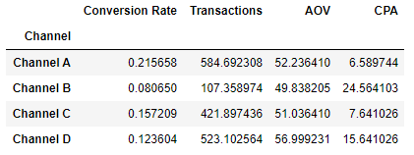
Top performing channel 1/1/16-2/4/16: Channel A
Highest average CR 21.6%
Highest average transactions 585
Lowest CPA $6.59
Lowest performing channel 1/1/16-2/4/16: Channel B
Lowest CR 8.1%
Lowest average transactions 107
Lowest AOV $49.84
Highest CPA $24.56

Slide 4
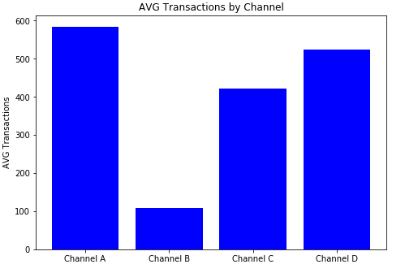
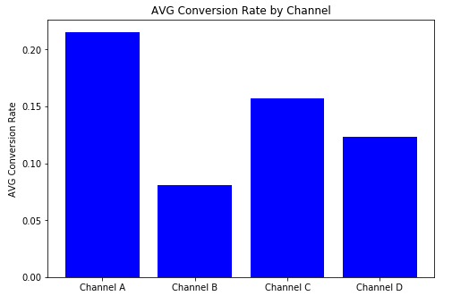
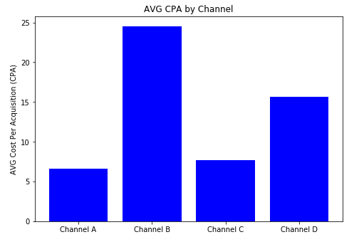
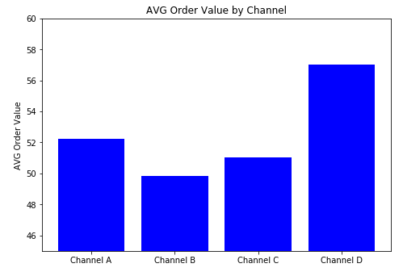

Slide 5
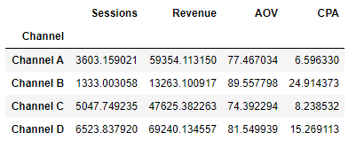
Top performing channel 2/9/16-12/31/16: Channel D
Highest average sessions 6524
Highest average revenue $69,240.13
Lowest performing channel 2/9/16-12/31/16: Channel B
Lowest Sessions 1333
Lowest revenue $13,263.10
Highest CPA $24.91

Slide 6
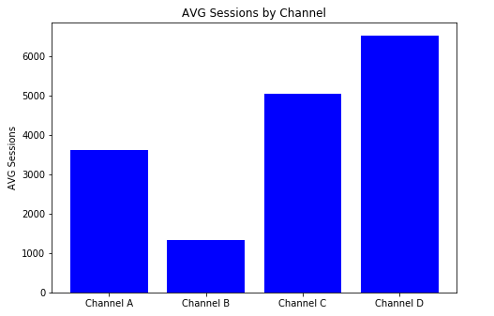
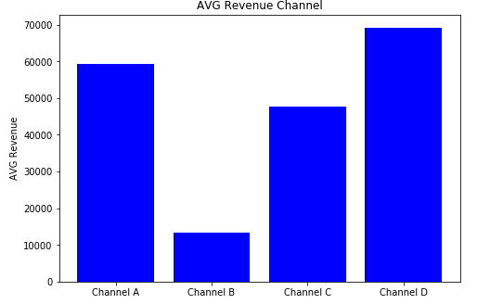
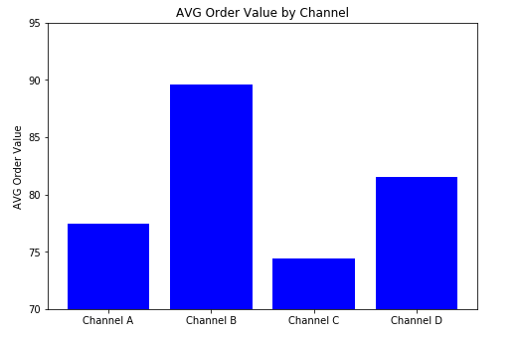
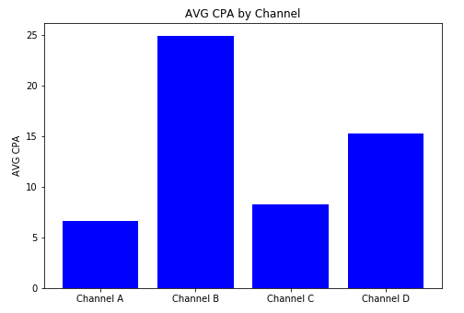

Slide 7
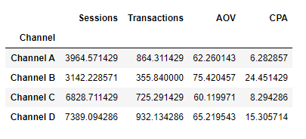
Top performing channels 1/1/17-12/31/17
Highest average sessions D 7389
Highest average revenue D 932
Lowest performing channel 2/9/16-12/31/16: Channel B
Highest CPA $24.45

Slide 8
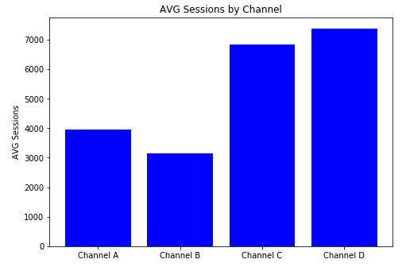
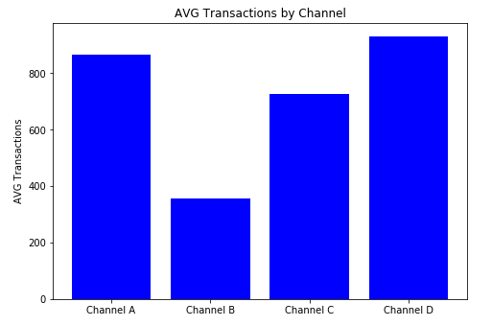
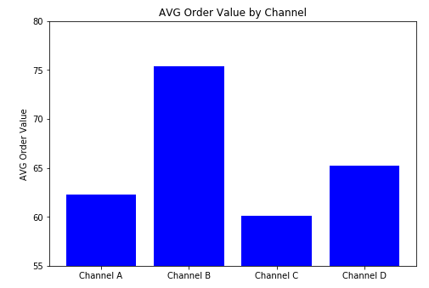
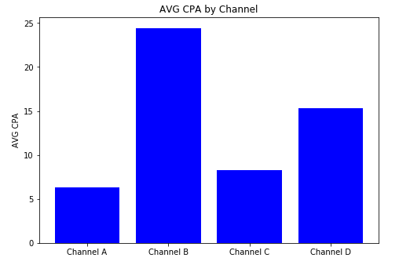

Slide 9
Cost/Revenue 2017
Using the available data, the approximate costs and revenue were calculated for 2017. For revenue, the AOV was multiplied by the number of transactions. For the costs, the CPA was multiplied by the number of transactions.
Revenue=AOV*Transactions
Costs=CPA*Transactions
The data were grouped by month for 2017.

Slide 10
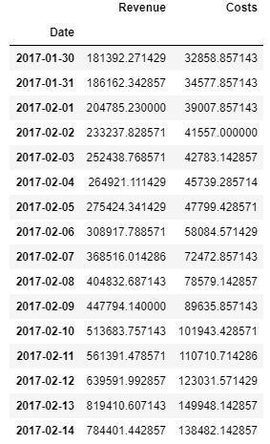
Cost/Revenue 2018
The 2018 Cost/Revenue was forecasted by day for the two weeks leading up to Valentine’s Day.
The forecast was based on the previous year’s cost/revenue using a rolling average.
The rolling averages for costs and revenue for the two weeks leading up to Valentine’s Day 2017 are shown in the accompanying table.

Slide 11
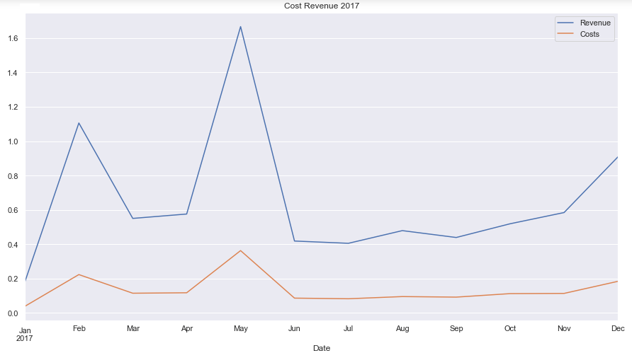

Slide 12


Summary: Recommendations
Increase use of channels A and D
Decrease use of channel B
Continue watching channel C for changes
Analyze changes from 2016 to 2017 by gathering additional data
Additional information needed:
Revenue for 2017
Costs for 2017

